Slide 1
KS2 SATs Information Evening
24th February

Slide 2
What will we cover in this meeting?
What are the SATs?
When are the SATs?
What do the questions look like?
Special arrangements
Writing
How can you help your child?
The week itself
Things to remember
Revision guides
Reminder about online safety

Slide 3
What are SATs?

Slide 4
SATs
The end of KS2 assessments are sometimes informally referred to as ‘SATs’.
SATs stands for Statutory Assessment Tests and they are held at the end of Key Stage Two.
It is a statutory requirement for year 6 pupils in state primary schools across the country to do the SATs.
Tests are created by the Standards and Testing Agency.
The tests assess a pupil’s understanding of the curriculum taught from Year 3 to Year 6.
KS1 SATS – Year 2
These are taken at the school’s discretion
KS2 SATS – Year 6

Slide 5
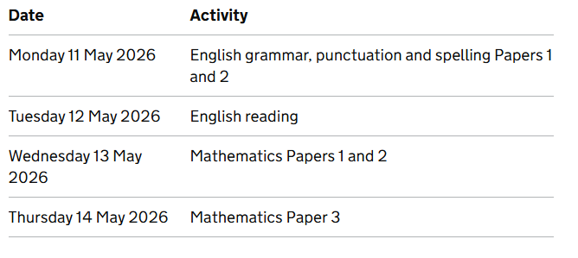
When are the SATs?
Writing is assessed using evidence collected throughout year 6. There is no year 6 SATs writing test.

Slide 6
Special Arrangements

Slide 7
SPECIAL ARRANGEMENTS
Children with additional needs (who have similar support as part of day-to-day learning in school) may be allotted specific arrangements including:
Additional time
Tests being opened early to be modified
An adult to scribe for them
An adult to read for them
The use of prompts or rest breaks
Arrangements for children who are ill or injured at the time of the tests
Pupils with an EHCP are automatically allowed up to 25% additional time (except for the spelling paper, which is not timed). Pupils who use the modified large print or braille versions of the tests are automatically allowed up to 100% additional time.

Slide 8

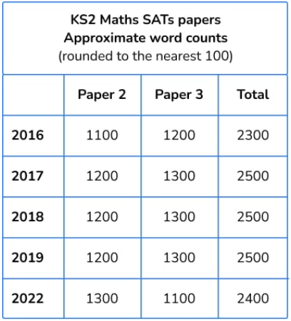
Paper content
Assistance
From DfE Test Administration Guidance...
If a pupil requests it, a question may be read to them on a one-to-one basis. If reading to a pupil, you can read words and numbers but not mathematical symbols. This is to ensure pupils are not given an unfair advantage by having the function inadvertently explained by reading its name.

Slide 9
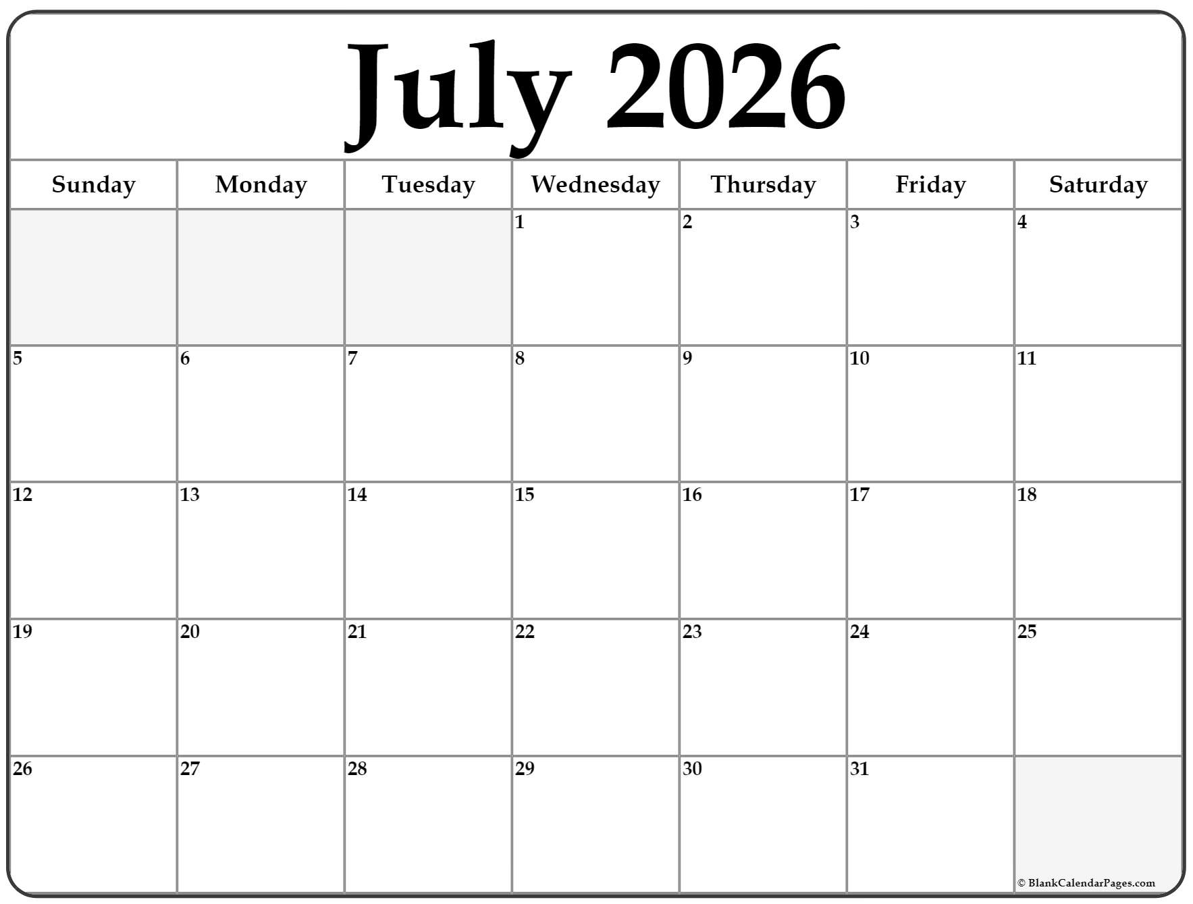
How are they graded?
SATs tests are marked externally; the school receives the results in July.
The marked tests will provide the following information:
  A raw score
  A scaled score
  An indication of whether the national standard has been met.

Slide 10
Grading of the Tests
A child awarded a scaled score between 100-109 is judged to have the ‘national standard’ (ARE/EXS) in the area judged by the test.
If a child’s score is 110 or above, they are working above the expected national standard (GDS).
If a child’s score is between 80-99, they are judged to have not yet met the national standard and performed below the expectation for their age (working towards).

Slide 11
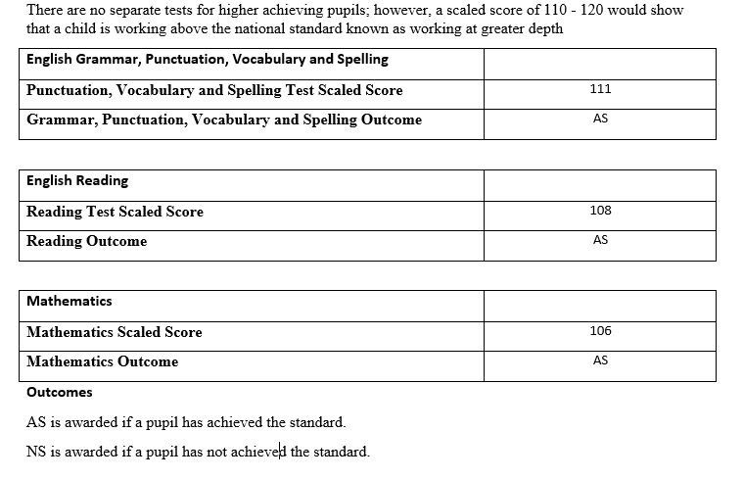
    How are the results published?
A score of 100 or above means your child is working at the expected standard.

Slide 12
What Do the Questions Look Like?

Slide 13

Spelling, Punctuation and Grammar: Paper 1
This test focuses on:
  Grammatical terms/word classes
  Functions of sentences
  Combining words, phrases and clauses
  Verb forms, tenses and consistency
  Punctuation
  Vocabulary
  Standard English and formality

Slide 14
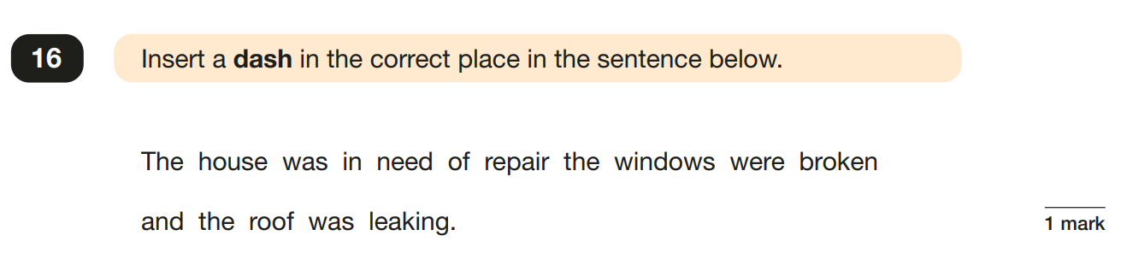
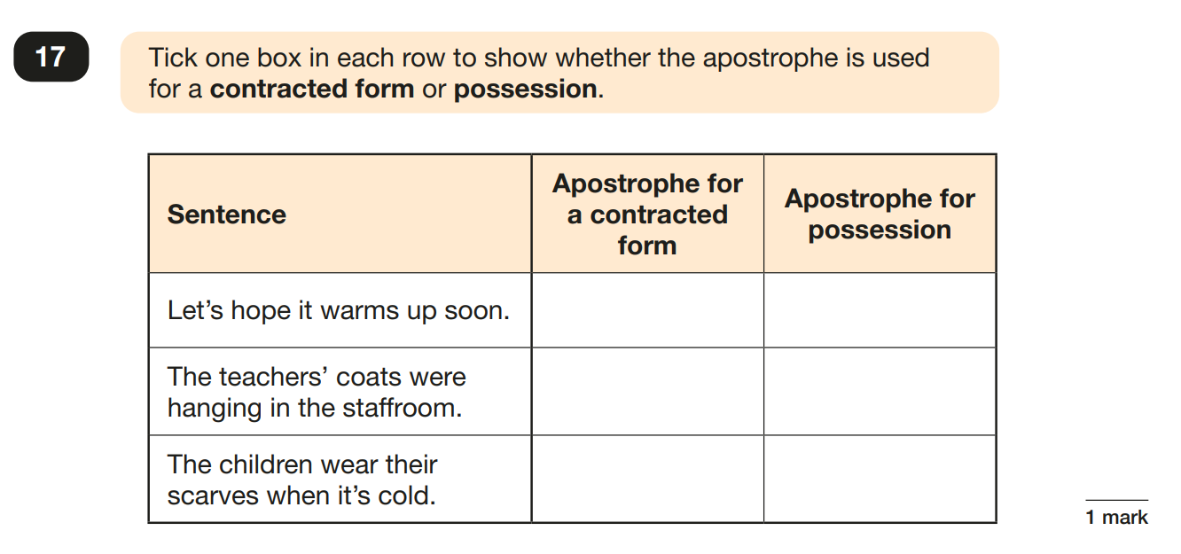
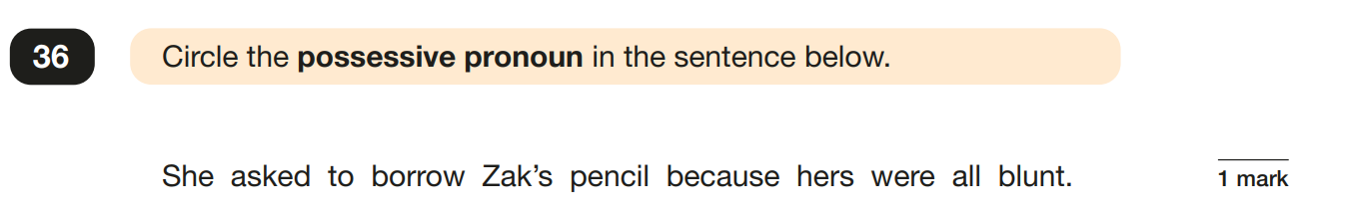
Spelling, Punctuation and Grammar: Paper 1

Slide 15
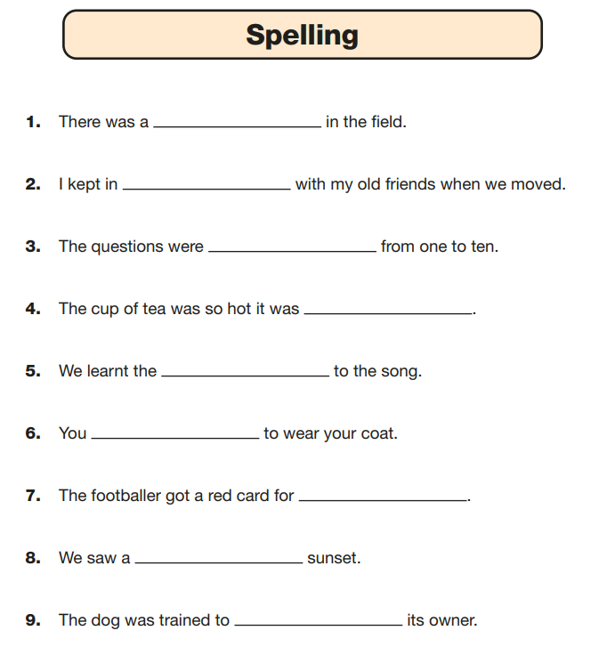
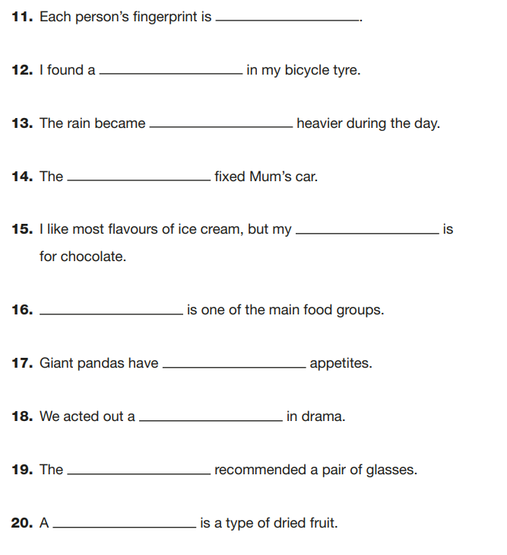
Spelling, Punctuation and Grammar: Paper 2
In this test, the teacher reads the missing word and then the sentence.
It focusses on spelling rules within the KS2 curriculum, such as different prefixes, suffixes, homophones and more.

Slide 16
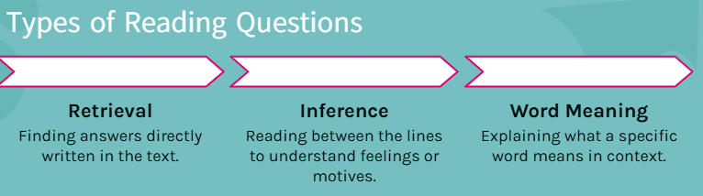

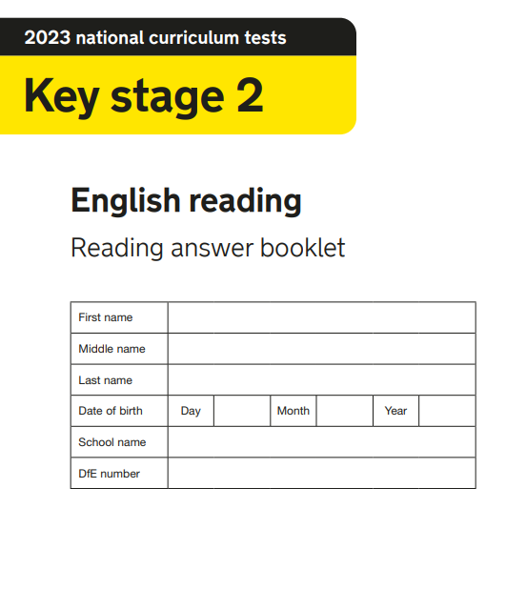
English reading

Slide 17
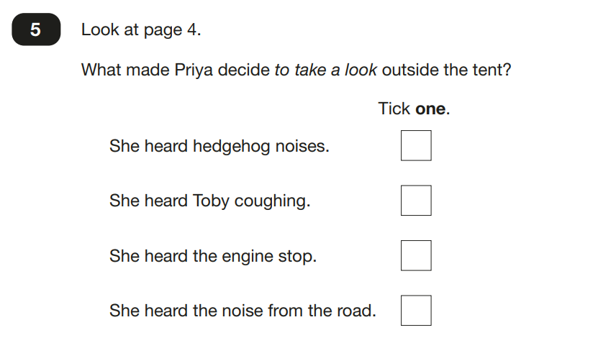
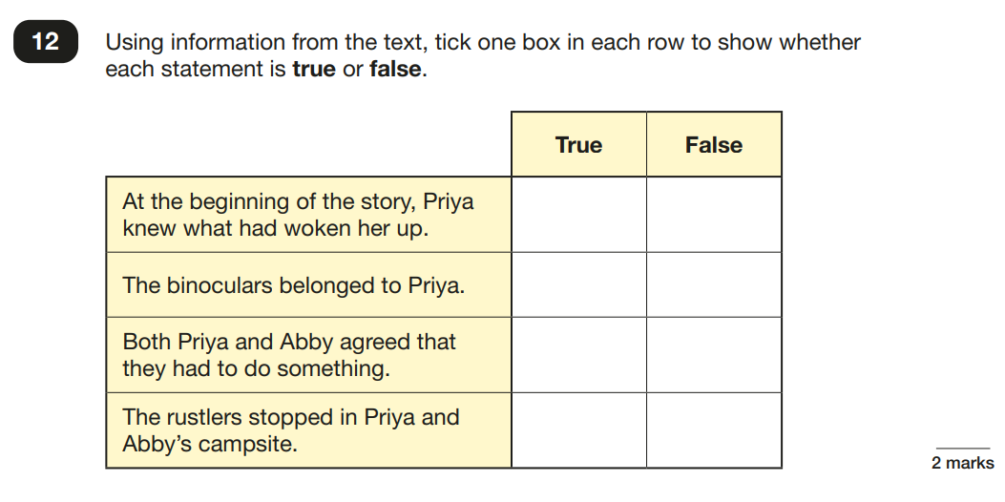
English reading

Slide 18
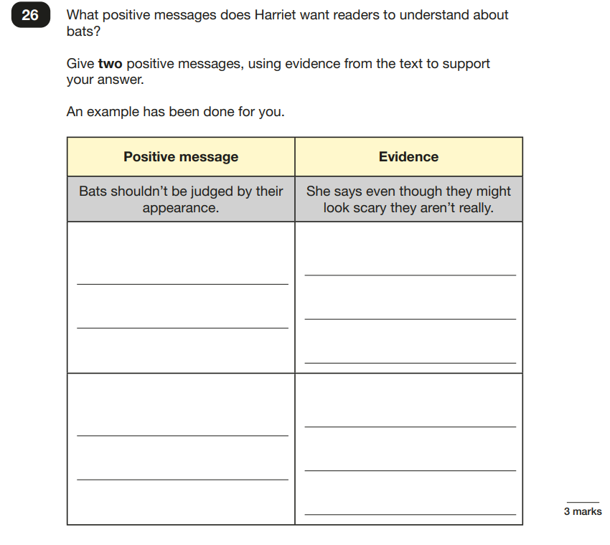
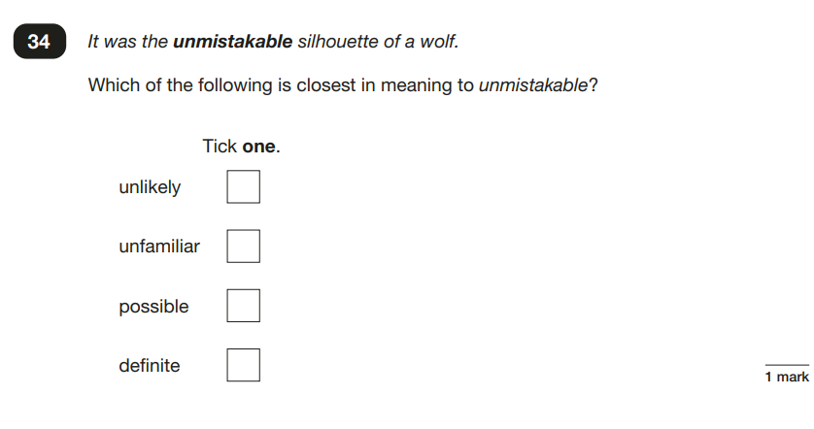
English reading

Slide 19
Writing

Slide 20
Writing Assessments
For writing, there is no testing. Instead, Y6 English teachers put together a portfolio of writing for each pupil.
We will then moderate together to grade pupils as WTS, EXS or GDS.
Some pupils may be pre-Key Stage, meaning that are still working at a similar level to Y2 or below. English teachers will make you aware of that prior to data submission.
Miss Whitcombe and Mr Snell then send the data off to DfE the week of Friday 26 June.

Slide 21
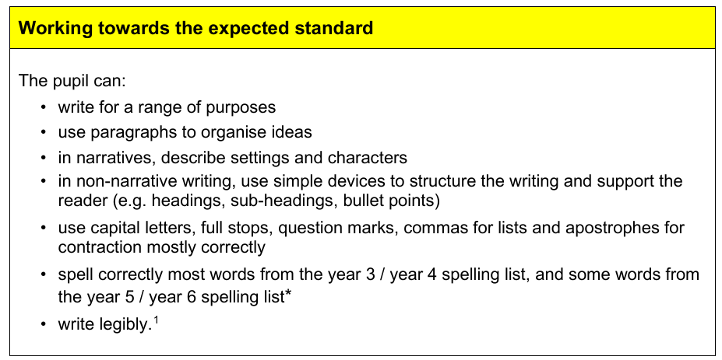

Slide 22
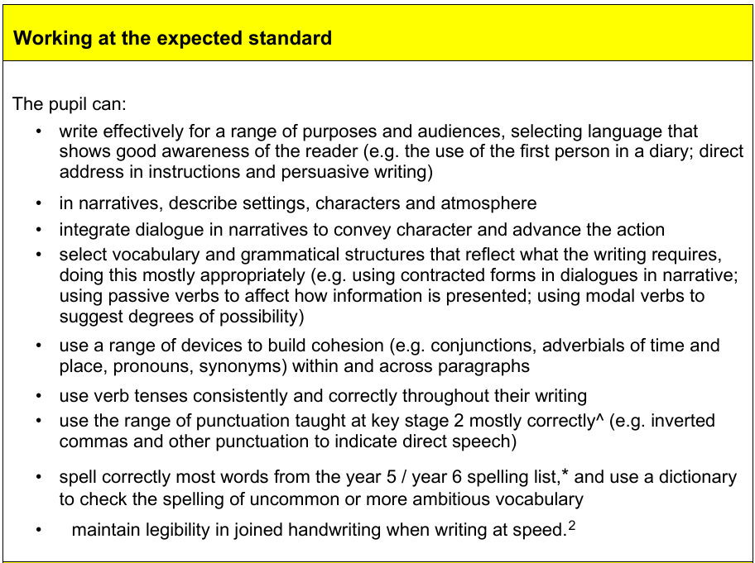

Slide 23
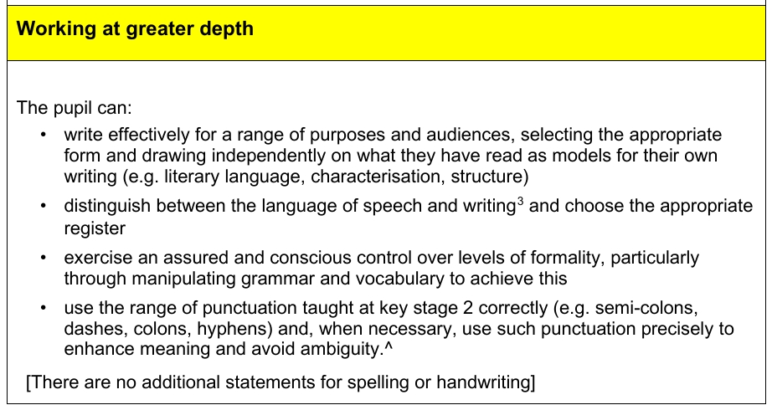

Slide 24

SATS Information Evening - Maths
February 2026

Slide 25


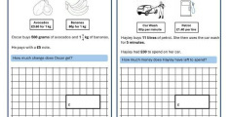

How the Maths SATs Are Structured
30 minutes
40 minutes
40 minutes
Arithmetic Paper
Tests fluency with calculations including long multiplication, division, fractions, and decimals.
Reasoning Paper 1
Includes word problems, multi-step questions, and application of maths skills.
Covers problem-solving, geometry, statistics, and algebra-based questions.
Reasoning Paper 2
Same structure and content type as Reasoning paper 1.

Slide 26
Which maths topics are covered?
Number & Place Value
Read, write, order numbers up to 10,000,000. Round whole numbers and decimals. Use negative numbers in context.
Calculations
Perform all four operations (including long multiplication/division). Apply BIDMAS.
Fractions, Decimals & Percentages
Understand equivalents, order, and simplify. Add/subtract fractions (different denominators). Multiply/divide fractions by whole numbers.
Ratio & Proportion
Solve problems with scale factors, percentages, and proportion using fractions and percentages.
Algebra
Solve simple formulae (missing numbers), generate linear sequences, and find number pairs for equations.
Measurement, Geometry & Statistics
Convert units (e.g., km to m), calculate area, perimeter, volume, understand shape properties and angles, and interpret graphs/timetables.

Slide 27
Types of exam questions
Multiple Choice: Select correct answer.
Fill in the Gaps: Complete calculations/sentences.
Matching: Link equivalents.
Multi-Step Problems: Solve real-life problems requiring multiple calculations.
Show Your Method: Write down working for full marks.
True/False & Explain: Decide if a statement is correct and explain why.

Slide 28
Practice papers
Over the course of the year, pupils have been practising SATS papers so that they are familiar with the layout and content of the papers.
In lessons, we have drip fed SATS questions when teaching each topic area.
Throughout year 5, pupils were also exposed to SATS style questions in daily lessons.
It is an accumulation of all of the work that they have learnt about during their key stage 2 journey – KS2 SATS and not just Year 6 SATS!

Slide 29
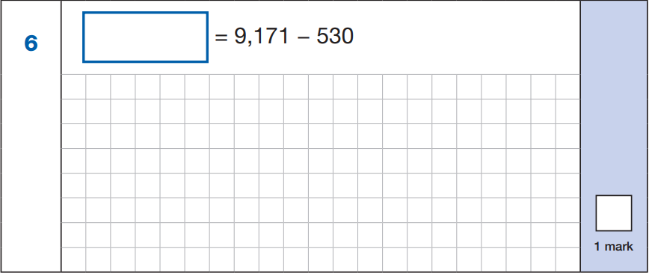
Example questions (Arithmetic)
Some questions in the arithmetic paper have the answer box at the start of the question (see below)

Slide 30
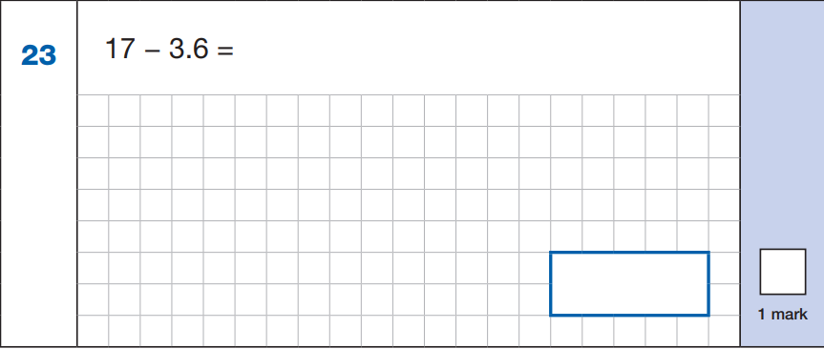
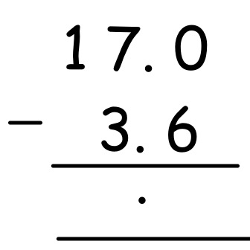
Example questions (Arithmetic)

Slide 31
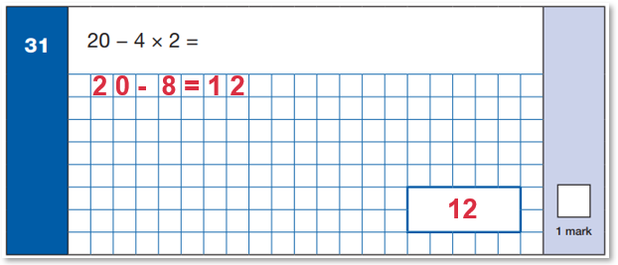
Example questions (Arithmetic)
In the arithmetic paper, the questions get progressively more difficult. Therefore, a question such as this, near the end of the paper which appears at first glance quite simple, is actually testing a more challenging skill – in this case BIDMAS.

Slide 32
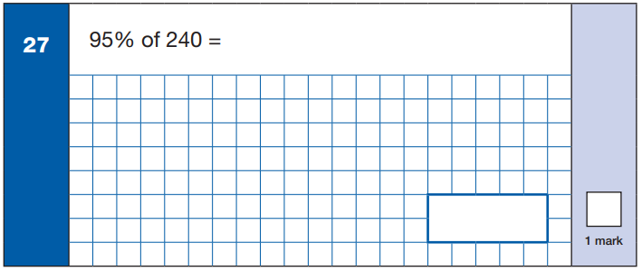
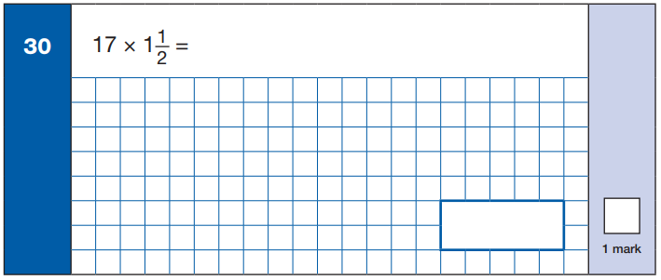
Example questions (Arithmetic)

Slide 33
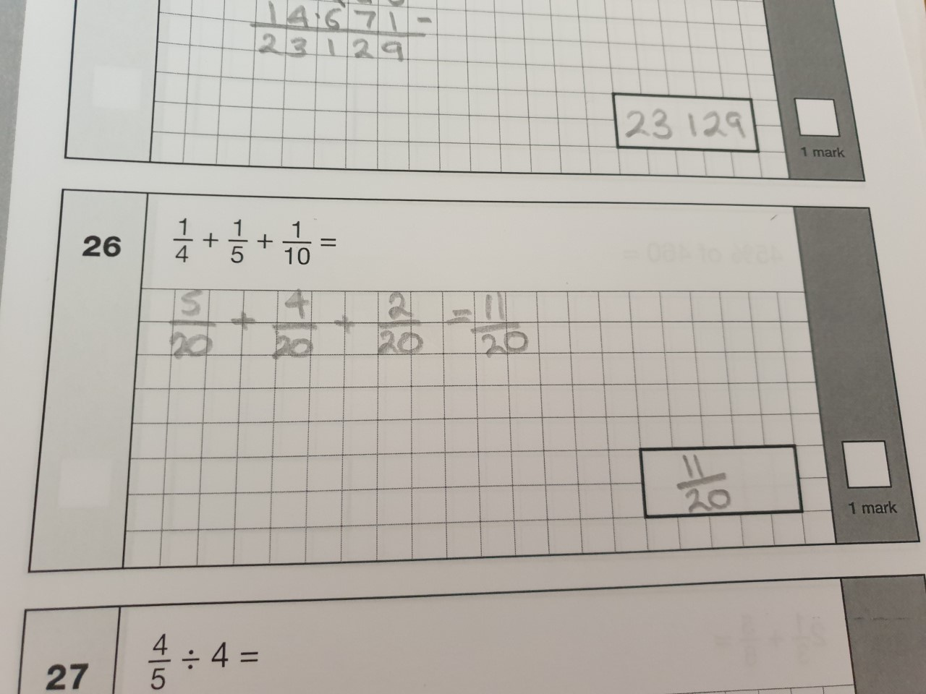
Example questions (Arithmetic)

Slide 34
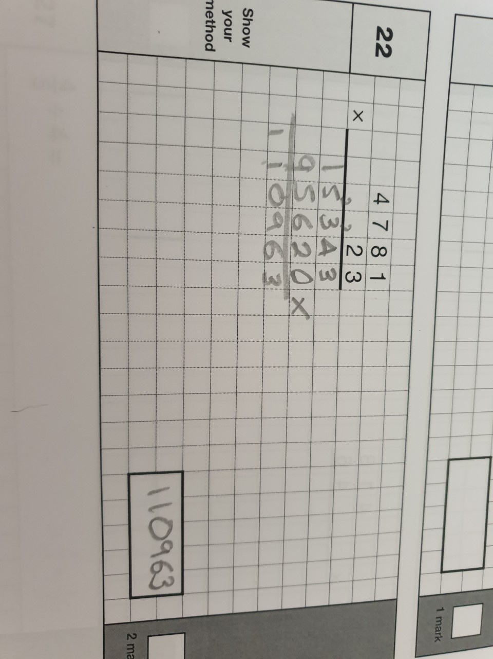
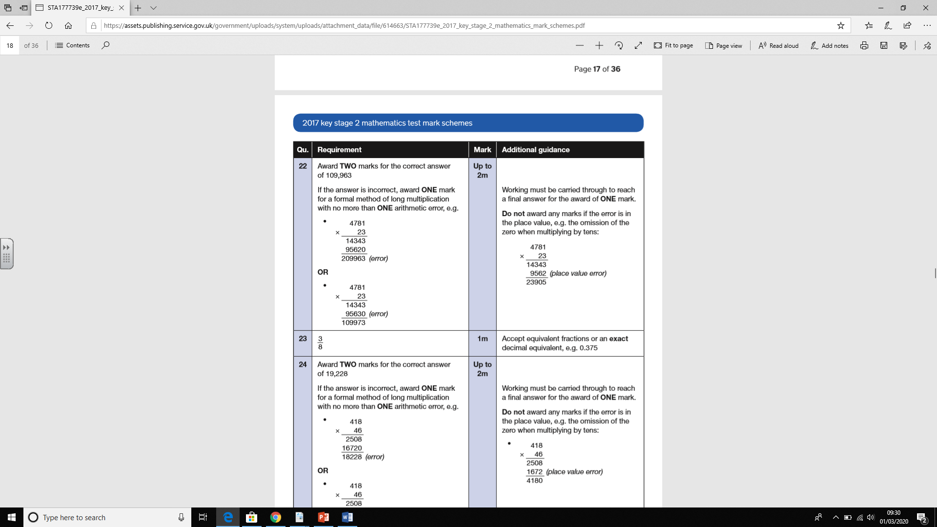

Example questions (Arithmetic)
The only questions in the arithmetic paper which are worth 2marks, are the long multiplication and long division questions.
There is one small calculation error within this calculation, so this would score 1 mark.

Slide 35
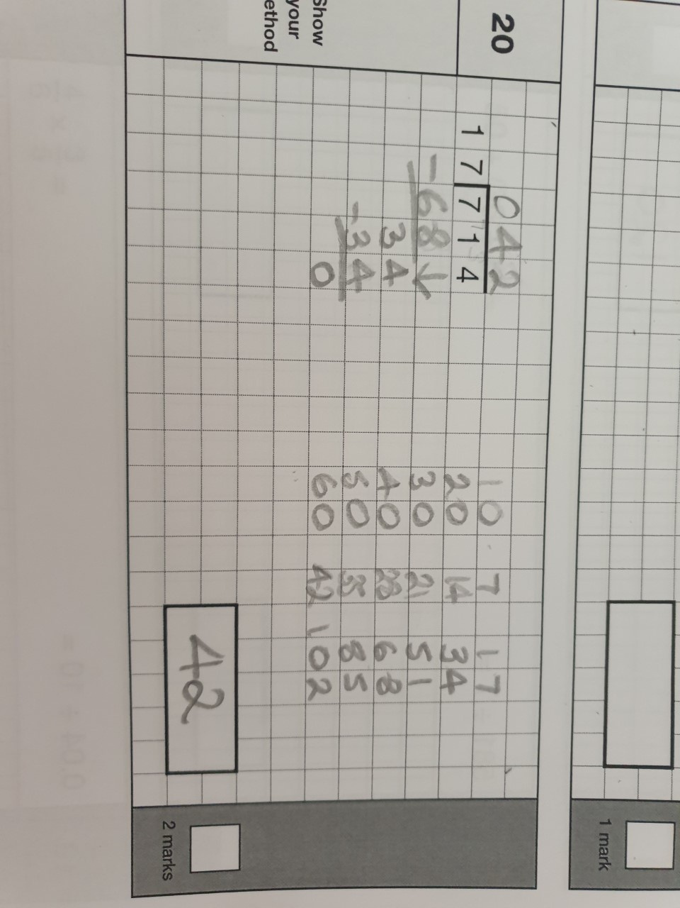
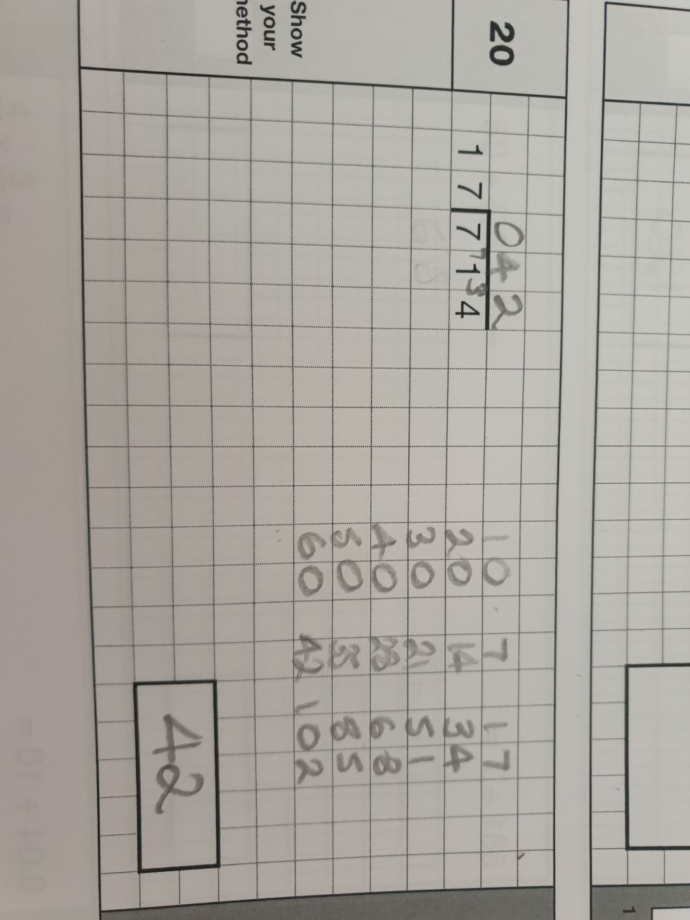
Example questions (Arithmetic)
This long division question is worth 2 marks.
Pupils will be awarded both marks for the correct answer using any chosen method.
However, only the first traditional method could gain 1 mark if there is a working out error within the calculation.

Slide 36
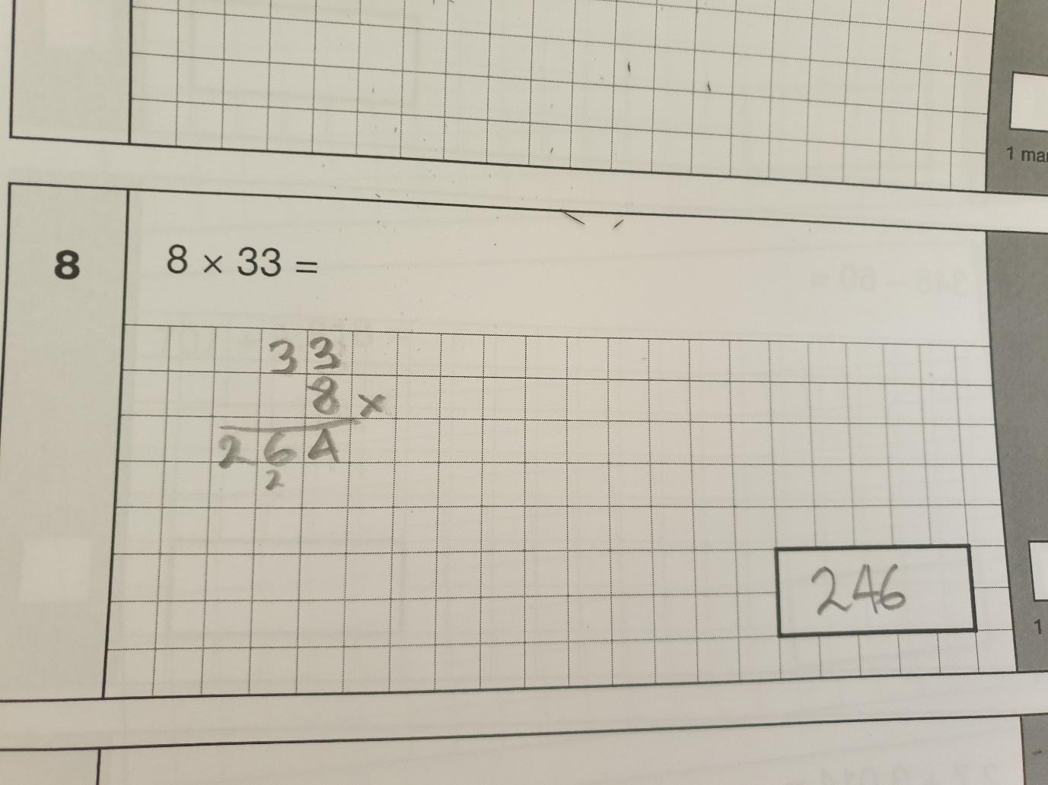
Common errors (Arithmetic)
Often pupils lose marks for an error when transposing
the answer to the answer box.

Slide 37
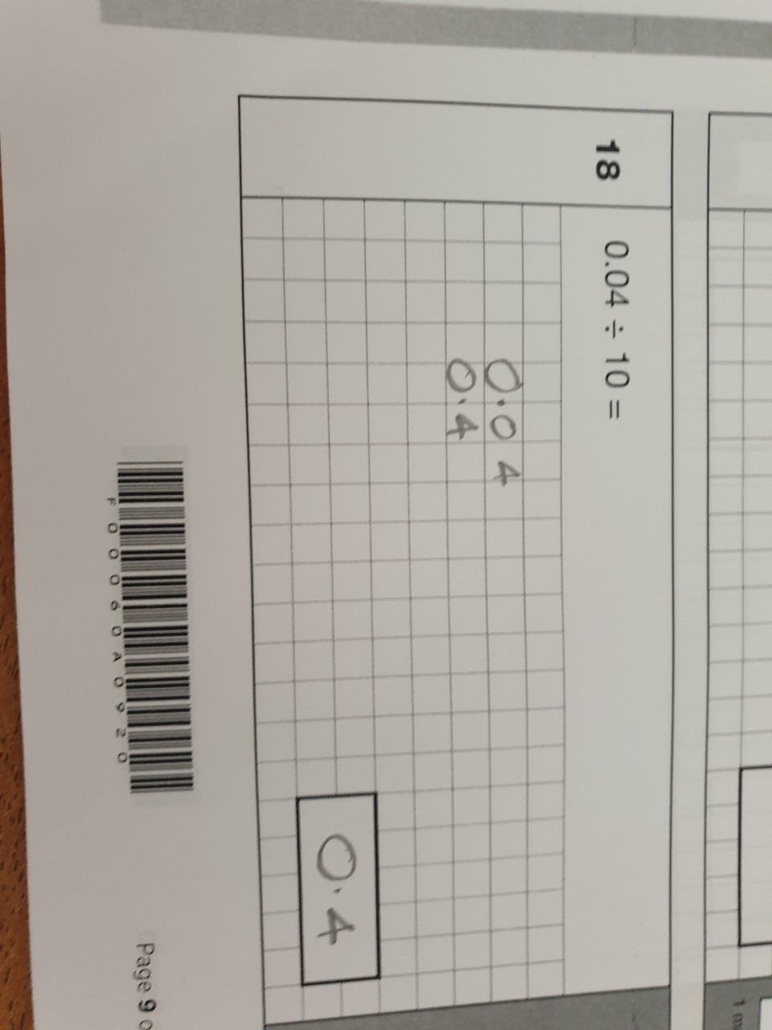
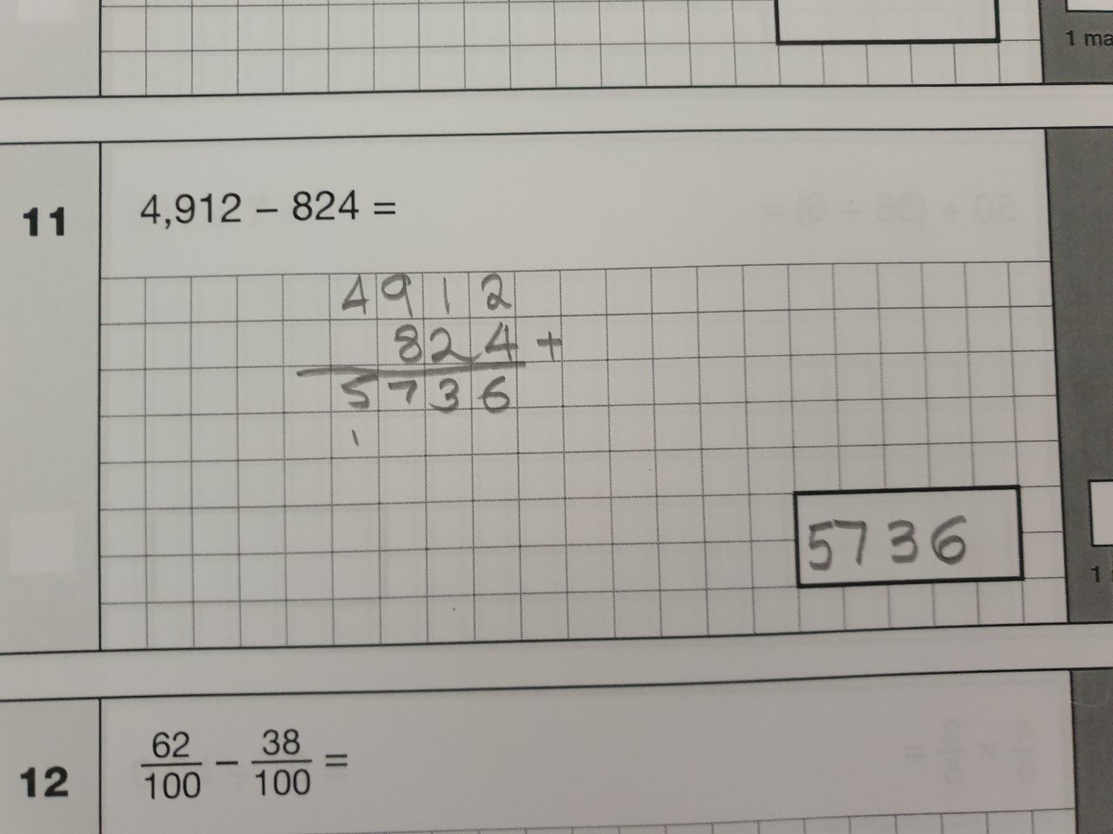



Common errors (Arithmetic)
Both of these errors have occurred due to pupils reading the question incorrectly and therefore completing the wrong calculation.

Slide 38
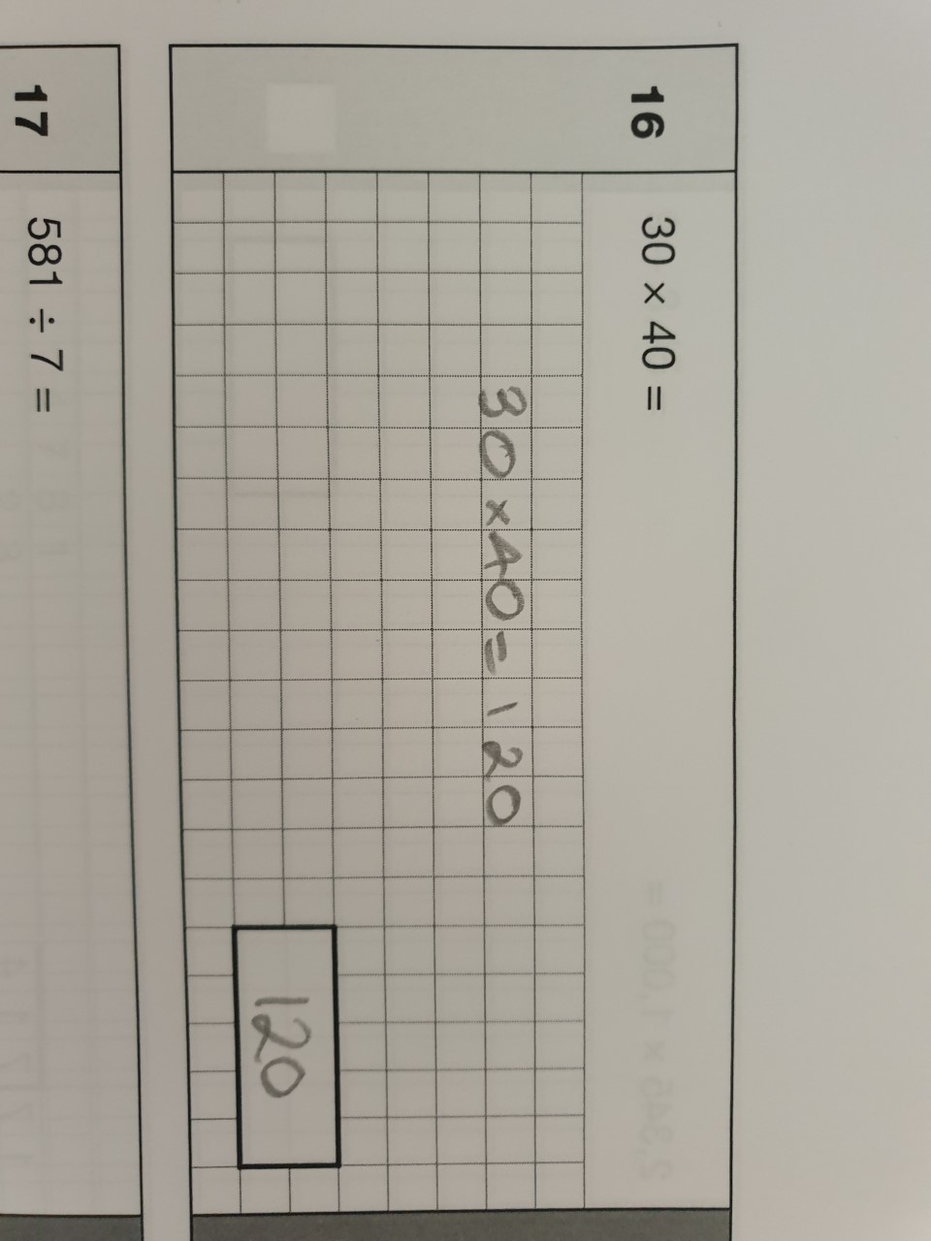
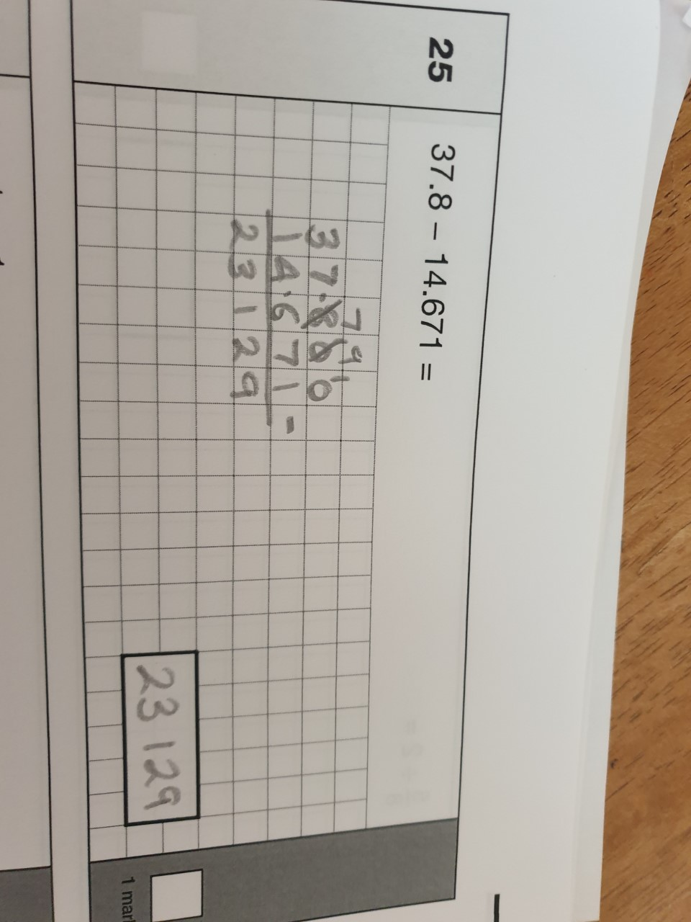



Common errors (Arithmetic)
All of the working out for the subtraction question below is correct but the pupil will not receive the mark due to the missing decimal point
within the answer.

Slide 39
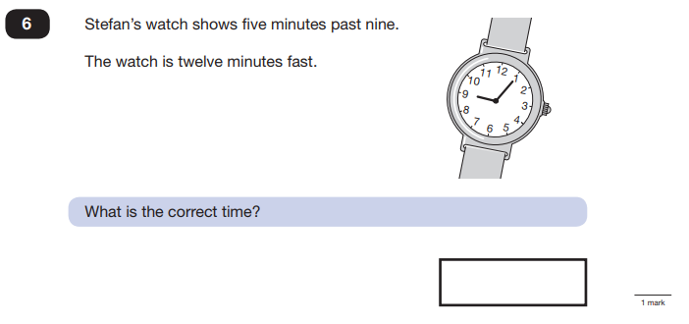
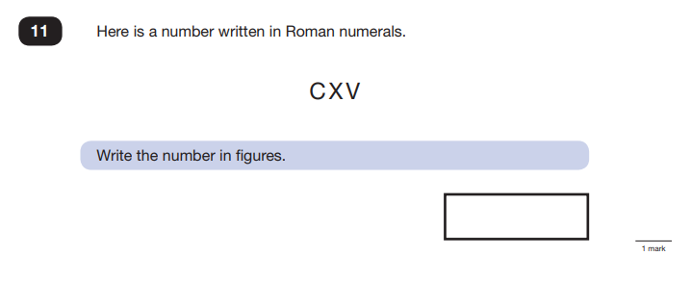
Example questions (Reasoning)

Slide 40
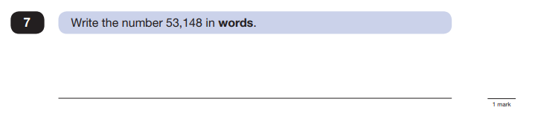
Example questions (Reasoning)

Slide 41
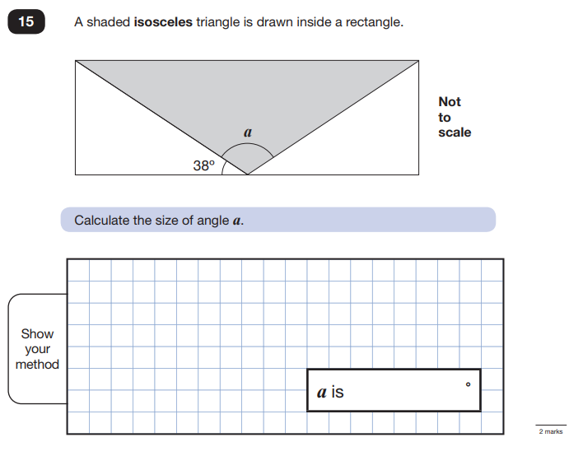
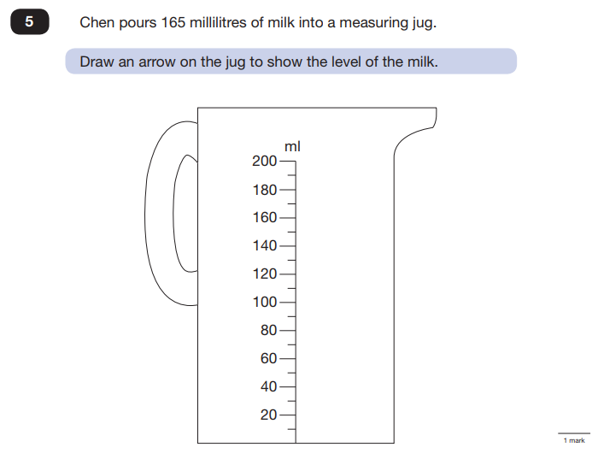
Example questions (Reasoning)

Slide 42
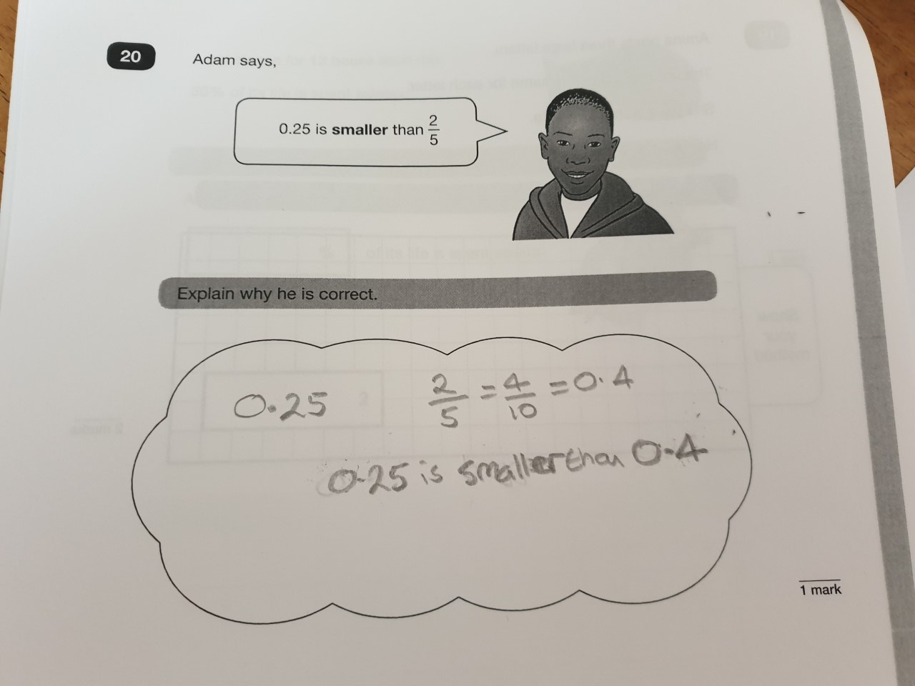

Example questions (Reasoning)

Slide 43
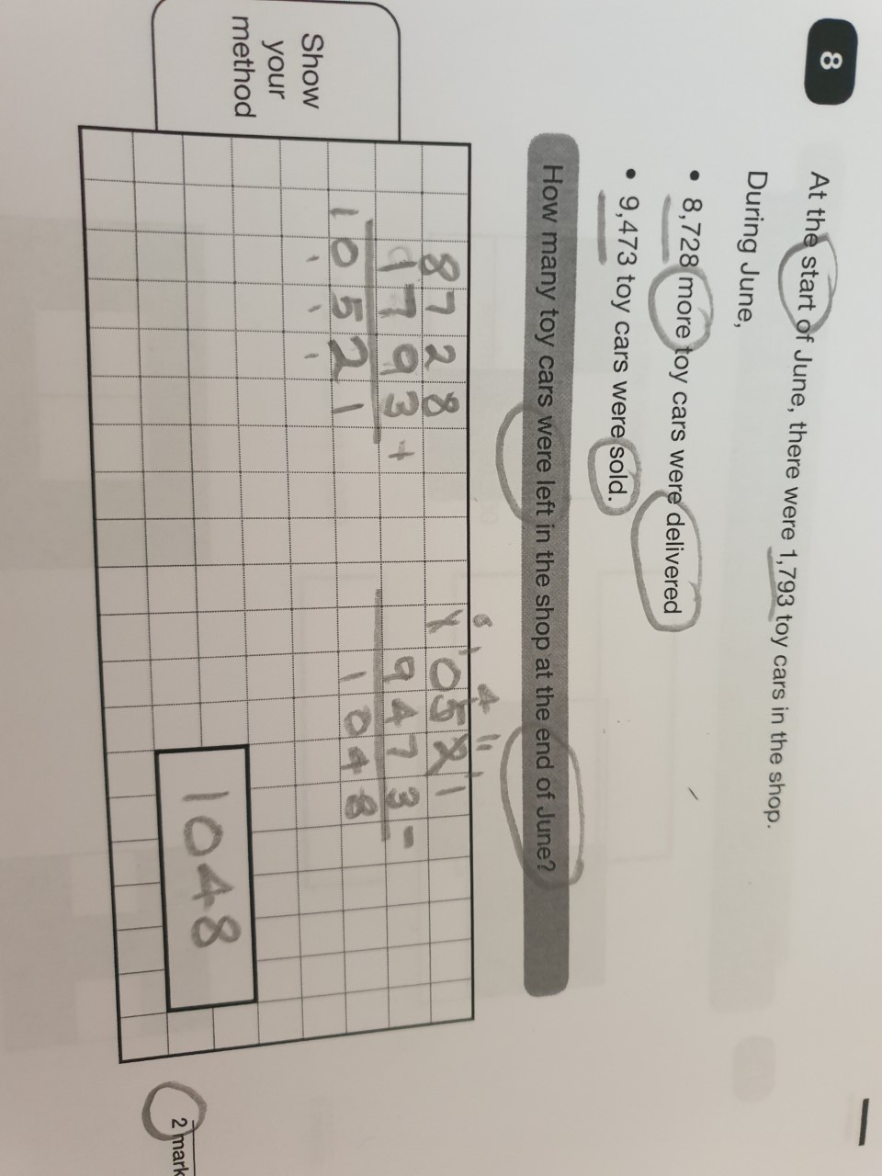
Example questions (Reasoning)
When a worded problem is worth 2 marks, there is usually more than one step of working out to carry out.

Slide 44
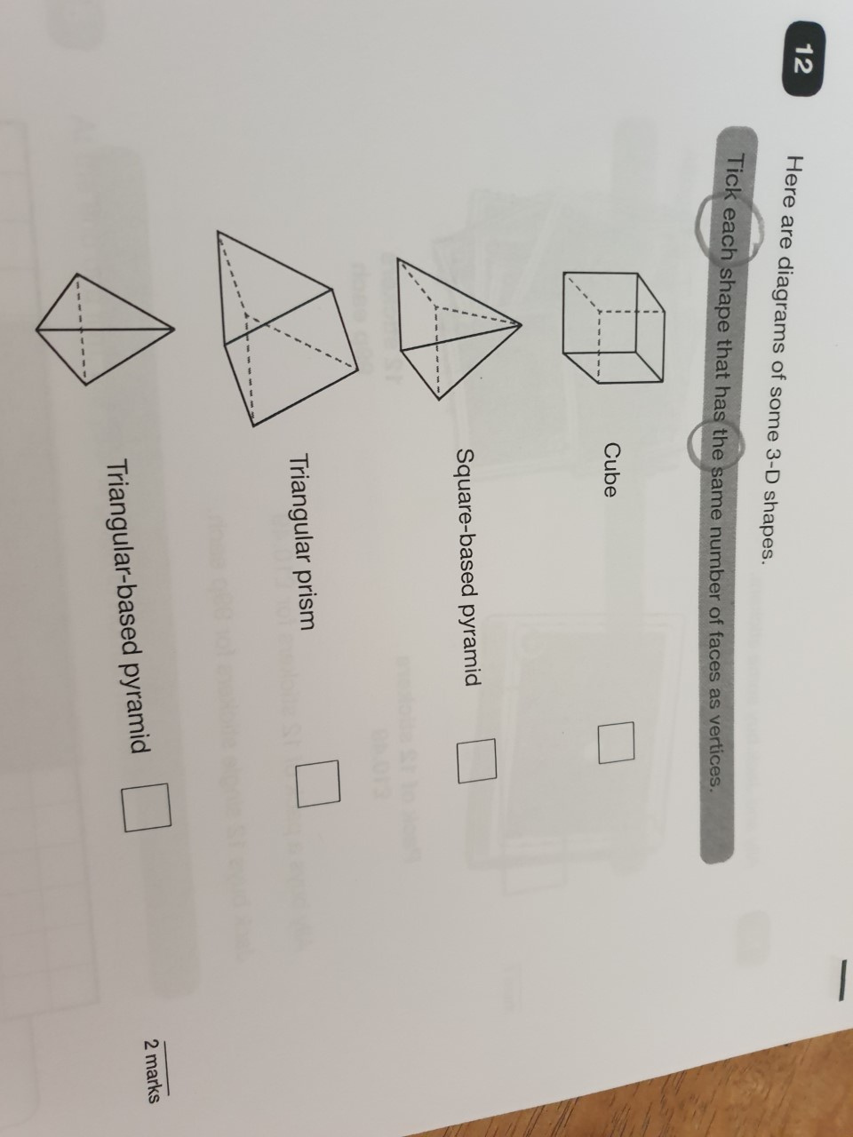
Example questions (Reasoning)
On questions like these, pupils should check each shape. Often they think if they have found one shape that answers the question, there will be no more.

Slide 45
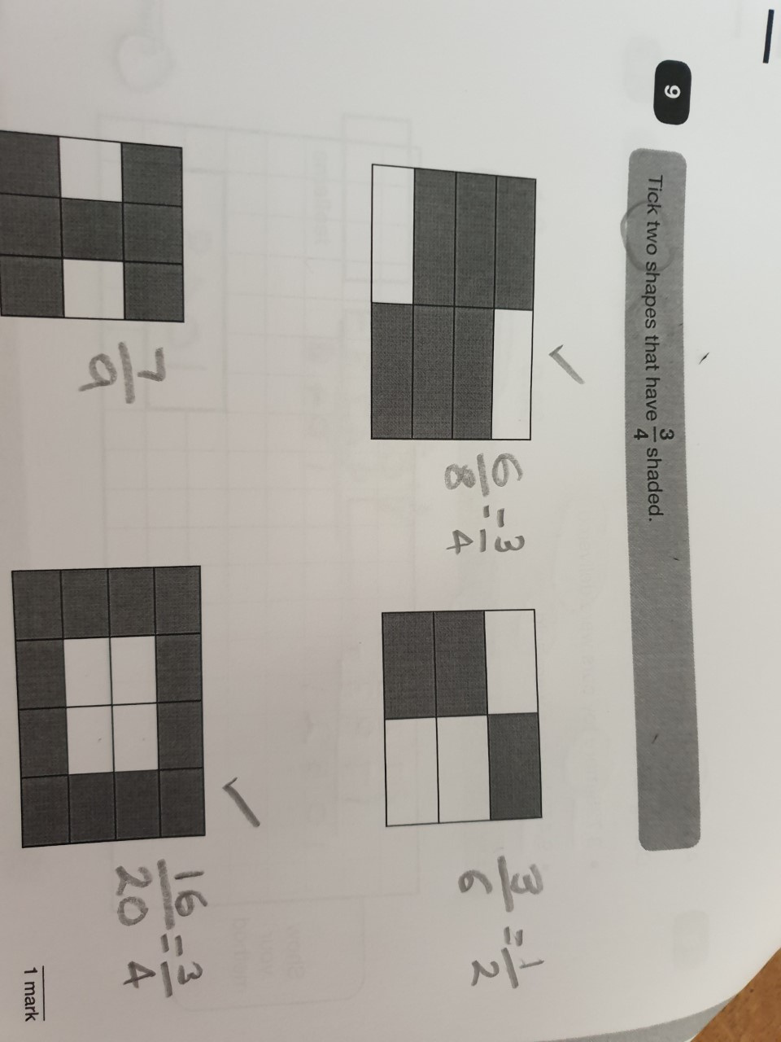
Example questions (Reasoning)
Ensure that the question is answered and two shapes have been ticked.

Slide 46
KS2 Maths SATs papers analysis by @Missie_Bee | KS2 Maths SATs papers analysis by @Missie_Bee | KS2 Maths SATs papers analysis by @Missie_Bee | KS2 Maths SATs papers analysis by @Missie_Bee | KS2 Maths SATs papers analysis by @Missie_Bee | KS2 Maths SATs papers analysis by @Missie_Bee | KS2 Maths SATs papers analysis by @Missie_Bee | KS2 Maths SATs papers analysis by @Missie_Bee
 | 2017 | 2018 | 2019 | 2022 | 2023 | 2024 | 2025
% required to 'pass' | 52 | 55 | 53 | 53 | 51 | 49 | 53
% of questions from years 3-5 curricula | 58 | 53 | 52 | 63 | 58 | 56 | 62
% of questions from weightiest content domains (calculations & FDP) | 36 | 43 | 54 | 63 | 58 | 67 | 59

Slide 47
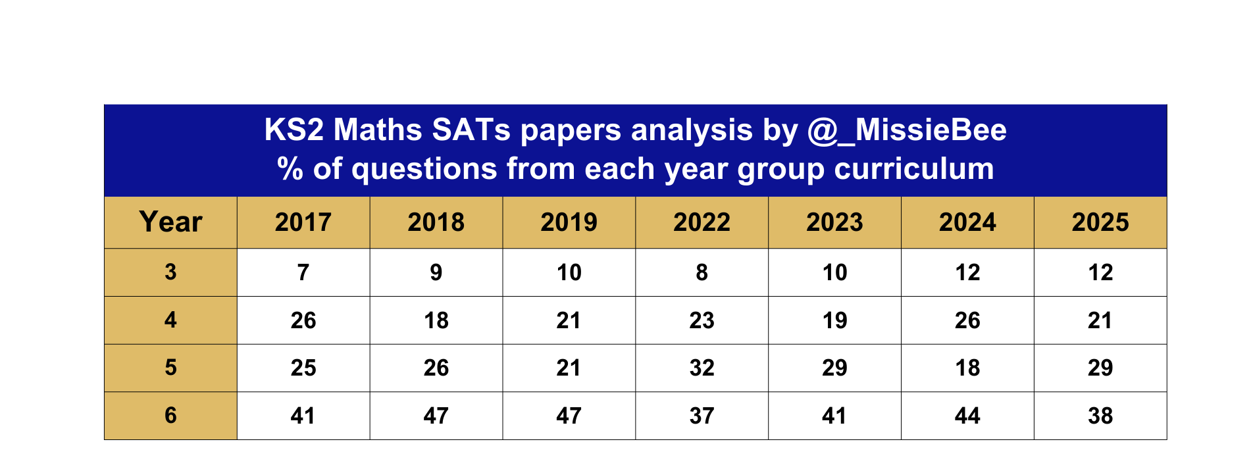
Paper content (by year group level)

Slide 48
How can you help your child?

Slide 49
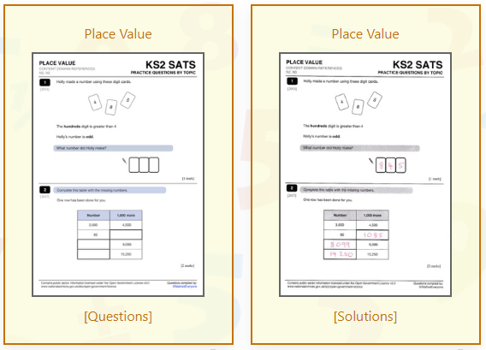
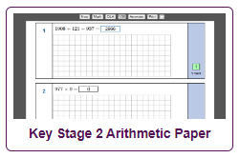
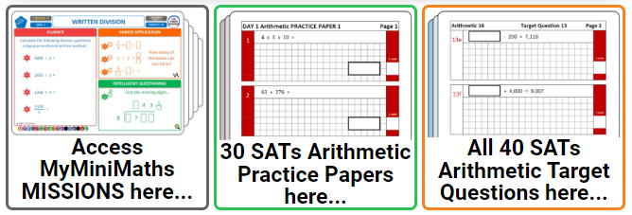
Supporting Resources
www.maths4everyone.com
www.mathsbot.com
www.myminimaths.co.uk
www.mathsisfun.com

Slide 50


Reading
Encourage a love of reading
Enjoy stories together
Read a little at a time but often
Talk about the story before, during and afterwards- discuss the plot, characters, their feelings and actions, how it makes you feel, predict what will happen and form opinions.
Look up definitions of unknown words
All reading is valuable. Reading can include: fiction, non-fiction, poetry, newspapers, magazines, football programmes and TV guides
Visit a library

Slide 51
SPAG
Identify different skills in the children’s reading book e.g. can you see an example of a fronted adverbial?
Practise spellings at home
Online spelling and grammar games (Crickweb | KS2 Literacy)
BBC Bitesize videos

Slide 52
Writing
Encourage opportunities for writing such as letters to family or friends, shopping lists, notes or reminders, stories and poems
Write together- be a good role model for writing
Encourage use of a dictionary to check spelling and a thesaurus to find synonyms and expand vocabulary
Remember that good readers become good writers!

Slide 53
THINGS TO REMEMBER
The wellbeing of your children is our priority.
It is important that the children feel calm and relaxed about their SATs.
We are here if you or your child has any concerns.
We are in this together; we believe in your children, and we will be doing everything to help them reach their full potential.

